Slide 1
A Two-minute presentation on Topic name (Times New Roman, 54 Font size, Center Aligned )
Presenter :
Presenter’s Name
Roll No.
Left Aligned, Times New Roman
Uniformity of presenter and supervisor should be there.
Supervisor (s):
Dr. XYZ,
Designation
Department
If two supervisors, then the font size may be reduced, but the text should be readable.
Research Conclave 2024

Slide 2
Content (Times New Roman, 44 Font Size)
Content should be point-wise, and may contain images, table, etc
The presentation time will be of 2 minutes only.
Participant is expected to demonstrate the research area, research background, and potential scope of work.
Times New Roman, Font size: Flexible. Participants may increase or decrease based on aesthetic requirements. However, everything should be readable.
PLEASE NOTE:
2-minute thesis presentation is mandatory for all PhD students who are yet to complete PhD. Registration and admitted before Autumn 2023
Research Conclave 2024

Slide 3
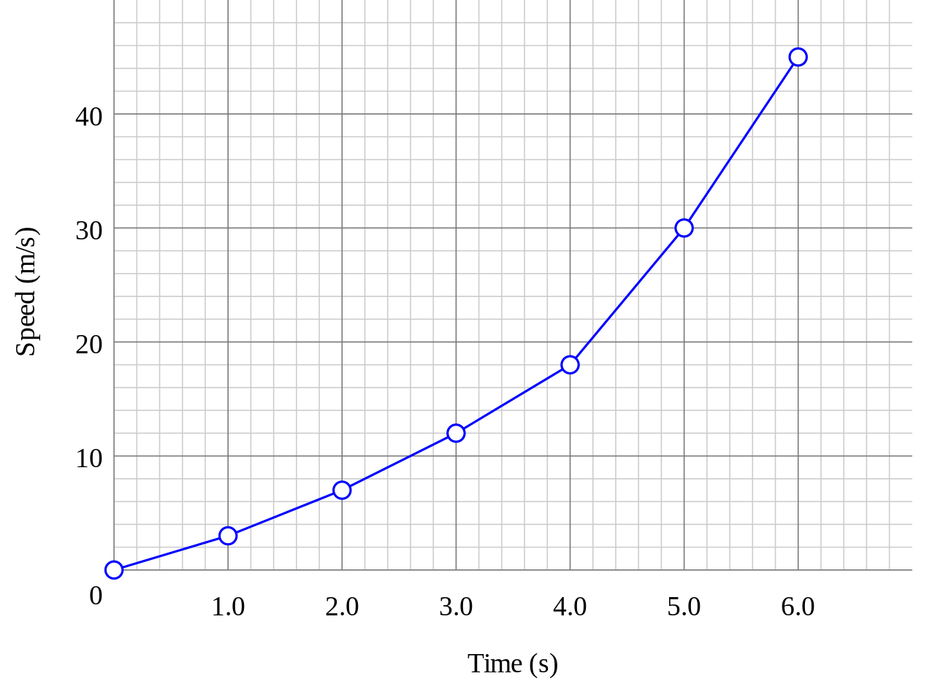
Number of Slide and Layout can be arranged in as per the individual requirement of participants
However, The present time should not exceed 2 minutes.
Figures, Tables, and graphs and data presented should be clearly visible.
Research Conclave 2024

Slide 4
Reference
Reference shall be numbered, reference style is flexible and upon the choice of participant.
However, should be uniform.
Research Conclave 2024

Slide 5
THANK YOU
Research Conclave 2024

